Slide 1
Classification Etiopathogenesis & pathophysiology of STEMI
Dr. Shahinlal.N
SR ,Department of Cardiology
Govt medical college, Kozhikode

Slide 2
FourthUNIVERSAL DEFINITION OF MYOCARDIAL INJURY & INFARCTION
MYOCARDIAL INJURY
Elevated Cardiac Troponin values > 99 th percentile of URL.
Myocardial injury ---- acute --rise and /or fall of cTn values.

Slide 3
CRITERIA FOR ACUTE MYOCARDIAL INFARRCTION(TYPES 1,2,3)
Acute myocardial injury with atleast one of the following
*symptoms of myocardial ischaemia
*new ischaemic ECG changes
*development of pathological Q waves
*imaging evidence of new loss of viable myocardium /new RWMA consistent with ischemia
*identification of a coronory thrombus by angiogram (not for type 2 or 3)

Slide 4
TYPES OF MI
Type 1
Type 2
Type 3
Type 4a
ype4b
Type 5

Slide 5
TYPE 1
Atherosclerotic plaque rupture /erosion
Intraluminal thrombus in one /more coronary arteries
Decreased myocardial blood flow
Myocardial injury

Slide 6
TYPE 2
Condition other than plaque rupture contributing an imbalance B/W myocardial O2 supply and demand
Coronary artery spasm
Coronary endothelial dysfunction
Tachyarrhythmias,Bradyarrhythmias
Anemia
Respiratory failure
Drugs & toxins
Hypotension/ severe Hypertension

Slide 7
TYPE 3
Sudden cardiac death with symptoms of ischemia, new ST elevation/LBBB/VF
Die before
blood samples for biomarkers can be obtained/ increase in biomarkers can be identified.

Slide 8
TYPE 4a/ TYPE 4b/TYPE 5
Type 4a> MI associated with PCI
Type 4b> MI associated with stent thrombosis
Type 5 > MI associated wit CABG.

Slide 9
TYPE 4A
PCI relted MI
CTn values > Five times the 99th percentile URL----Pt with norml base line values.
Pts with elevated pre procedure CTn , Post procedure value must raise by >20%

Slide 10
In addition one of the following
*symptoms of myocardial ischaemia
*new ischaemic ECG changes
*development of pathological Q waves
*imaging evidence of new loss of viable myocardium /new RWMA consistent with ischemia
*identification of a angiographic complications (coronary dissection/occlusion of a major epicardial artery/ thrombus)

Slide 11
TYPE 4B
Stent/scaffold thrombosis.
Acute ------- 0-24 hr
Sub acute ------- > 24 hr-30 days
Late ------- > 30 days- 1 year
Very late ------- > 1 year

Slide 12
Criteria for TYPE 4B
CTn value more than 99th percentile URL with atleast one of the following
*symptoms of myocardial ischaemia
*new ischaemic ECG changes
*development of pathological Q waves
*imaging evidence of new loss of viable myocardium /new RWMA consistent with ischemia
*identification of a coronory thrombus by angiogram

Slide 13
TYPE 5
CABG related MI
Elevated cTn values > 10 times the 99 th percentile URL.(Normal base line cTn)
Elevated pre procedure value----post procedure cTn must rise by >20%.

Slide 14
TYPE 5.
In addition one of the following.
1. Development of new pathological Q waves
2. Angiographic evidence of new graft occlusion/ new native coronary artery occlusion.
3. Imaging evidence of new loss of viable myocardium/New RWMA.

Slide 15
ACUTE CORONARY SYNDROME
Spectrum of conditions occurs due to acute myocardial ischemia/ infarction
Abrupt reduction in coronary blood flow

Slide 16
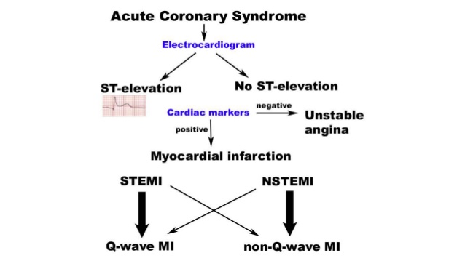

Slide 17
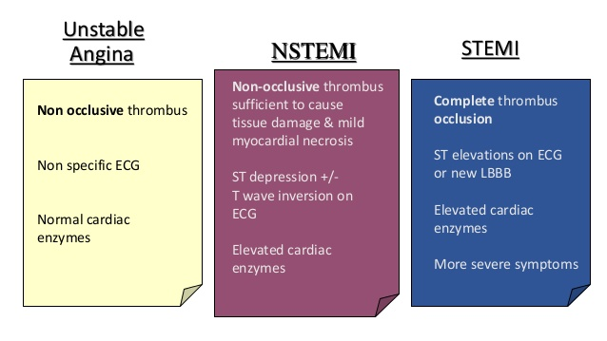

Slide 18
ECG & MI
ST Elevation
New ST elevation at j point in two contiguous leads
>0.1 mv in all leads except V2/V3
in V2/V3
>0.2 mv in men>40 yrs
>0.25mv in men<40 yrs
>0.15 mv in woman

Slide 19
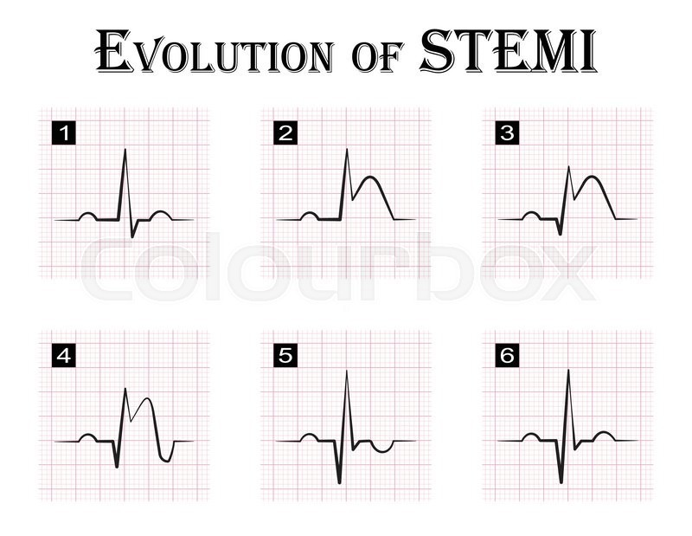

Slide 21
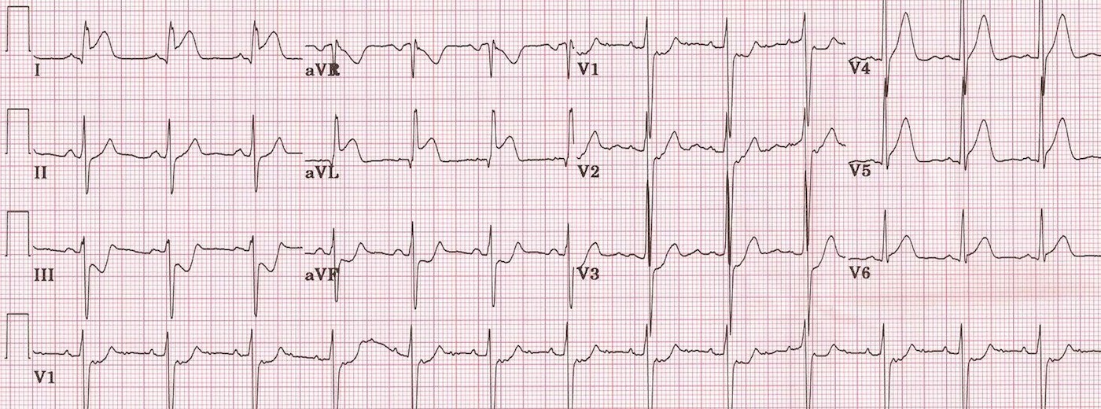

Slide 22
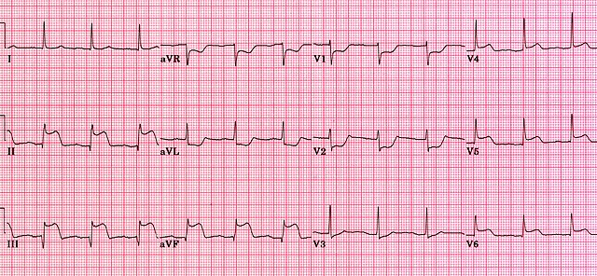

Slide 23
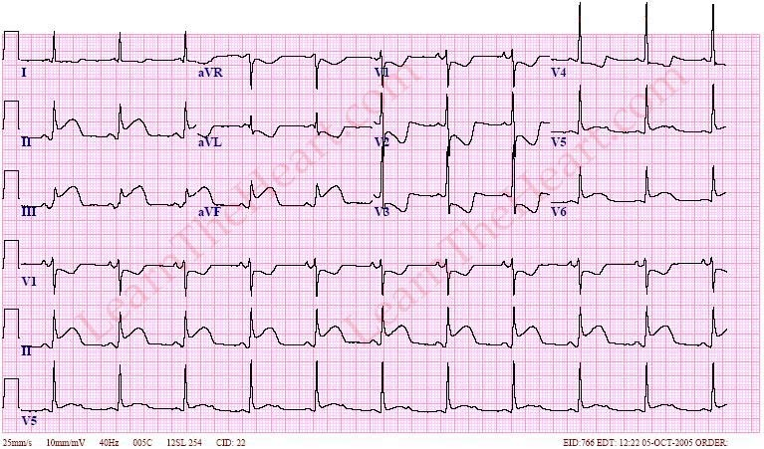

Slide 24
In setting of LBBB
ST elevation > 1mm & concordant QRS complex-------5 points
ST segment depression > 1mm in V123
---------3 points
Discordant ST sement elevation> 5mm
----------2 points
Score >3 -----98% specific for acute MI

Slide 25
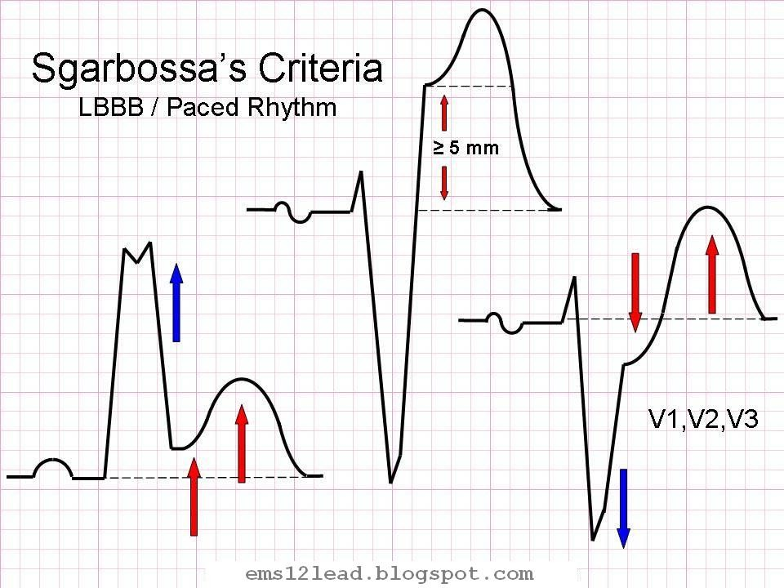

Slide 26
ST depression & T wave changes
New horizontal/downslopping ST depression
>0.05 mv in two contiguous leads
T inversion >0.1 mv in two contiguous leads

Slide 27
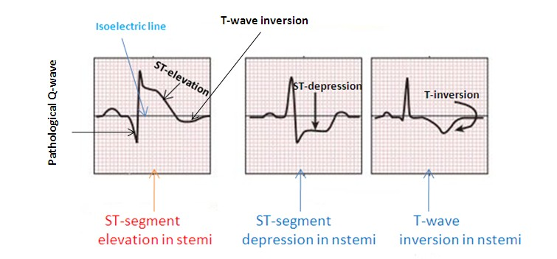

Slide 28
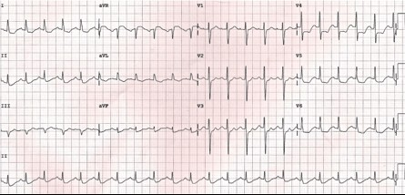

Slide 29
ATHEROSCEROTIC DISEASE
> 90 % CAD Culprit cause is found to be
ATHEROSCLEROTIC DISEASE

Slide 30
INTERHEART TRIAL
52 countries
Africa/Asia/North and south America.
Identified 9 easily measured risk factors for acute MI.
Smoking/ Hyperlipidemia/HTN/DM/Obesity/Diet/Physical activity/Alcohol consuption/Psychosocial factors.

Slide 34
ATHEROMATOUS PLAQUE-PATHOGENESIS
1.Chronic endothelial injury
(HTN/Hyperlipidemia/smoking/Toxins/virus/ immune reactions)
increased vascular permeability,leukocyte adhesion, thrombosis.
2.Accumulation of lipoprotein
oxidised LDL
3.Monocyte adhesion to endothelium
macrophages & T cells absorb oxidised LDL and HSP-------→foam cells

Slide 35
4.Platelet adhesion
5. Factor release
platelet ,macrophages,endothelium……..>PDGF , FGF ,TGFα……..>induce SMC recriutment from media
6. SMC proliferation and ECM
7.Lipid accumulation

Slide 36
ATHEROSCLEROTIC PLAQUE-CONTENTS
1.CELLS
Smooth muscle cells,macrophages,T cells
2. ECM
collagen,proteoglycans ,elastic fibres
3. LIPIDS

Slide 38
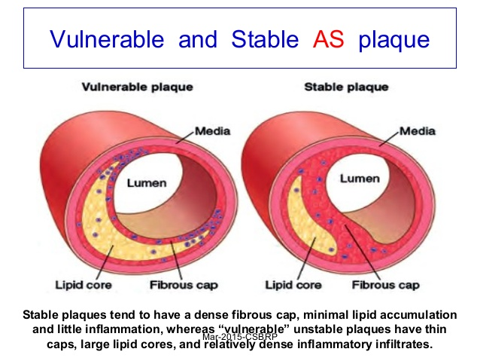

Slide 39
Atherosclerotic plaque changes
Rupture, Ulceration,erosion
Hemorrhage in to a plaque
Athero embolism
Aneurysm formation

Slide 40
NON ATHEROSCLEROTIC CAUSES OF MI
1.Embolisation into coronary artery
infective endocarditis/NBTE
prosthetic valve
neoplasm
air induced at cardiac surgery
hypercoagulable states
2.Spontaneous coronary artery dissection

Slide 41
Continues--
3.syphilitic aortitis
occlusion of coronary ostium
4.vasculitis
Takayasu’s arteritis,PAN,Kawasaki,SLE,Giant cell arteritis
5. Meadiastinal irradiation
6.Hurler’s syndrom

Slide 42
-----
7.Pseudoxanthoma elasticum
8.Homocystinuria
9.cocaine

Slide 43
MI NOCA (MYOCARDIAL INFARCTION WITH NONOBSTRUCTIVE CORONARY ARTERIES)
MI with angiographically normal or coronary artery stenosis less than 50%
Young females
CAUSES
coronary vasospasm
dissection
coronary emboli

Slide 44
continues
Hematological disorders
Polycythemia rubra vera
Sickle cell anemia
DIC
TTP
Augmented oxygen demand
Thyrotoxicosis
Amphetamine

Slide 45
continues
Hypotension
sepsis ,blood loss, drugs
Anatomical variations
anomalous origin of coronary artery, coronary AV fistula, myocardial bridge

Slide 46
Continue—
Prognosis….>Good compared to Atherosclerotic MI
Most common mimickers of MI……Acute myocarditis, Acute stress cardiomyopathy(Tako tsubo)

Slide 47
PATHOPHYSIOLOGY OF MI LV Dysfunction
Systolic dysfunction
4 abnormal contraction pattern
Dysynchrony
Hypokinesia
Akinesia
Dyskinesia
Severe depression of myocardial contractility
Increased end systolic volume
Decreased CO
Decreased BP
Diastolic Dysfunction

Slide 48
Ventricular Remodelling
Change in
Size, shape,thickness involving both infarcted & non infarcted segments of ventricle
A) Infarct expansion
B)Ventricular dilatation

Slide 49
………..
A) Infarct expansion
acute dilatation & thinning of area of infarction not explained by additional myocardial necrosis.
slippage b/w muscle bundles
disruption of normal myocardial cells
destruction of extra cellular matrix.

Slide 50
Continue
Degree of infarct expansion ……pre infarction wall thickness
existing hypertrophy possibly protect against infarct thinning.
Apex---Thinnest vulnerable for infarct expansion .
High mortality….Heart failure/ V.aneurysm/ Arrhythmias

Slide 51
---
B)Ventricular dilatation
Dilatation of viable portion of ventricle
compensatory mechanism to maintain stroke volume
Start immediately after STEMI
can progress for months---years

Slide 52
EFFECT OF Rx
Acute reperfusion------Restrict extent of myocardial necrosis
Steroids & NSAIDS----early MI----Scar thinning & infarct expansion.
RAAS inhibitors/ ARB/Aldosterone antagonist--------------reduce remodelling.

Slide 53
Pathophysiology of other organ systems
LUNG
Increased pulmonary capillary hydrostatic pressure-------interstitial edema----arteriolar & bronchiolar compression---hypoxemia
Hyperventilation------Respiratory alkalosis
TLC ,FRC,RV,VC

Slide 54
Endocrine
Pancreatic blood flow
Insulin
Sympathetic activity→catecholamines
Glycogenolysis→hyperglycemia
Safest post MI glucose level <180mg/dl

Slide 55
Adrenal medulla------→increased Catecholamine release
serious arrhythmias,extensive myocardial damage,cardiogenic shock.
increased thromboxaneA2…….>platelet aggregation
RAAS activation

Slide 56
NATRIURETIC PEPTIDE
ANP,BNP--------------from atrias
BNP & NT- pro BNP --------from ventricles
rise in BNP and NT-proBNP after STEMI correlates with infarcts size and RWMA

Slide 57
RENAL FUNCTION
CO AKI

Slide 58
HAEMATOLOGICAL
* propensity for platelet aggregation
* leucocytes
* viscosity

Slide 59
Pathological changes after MI
GROSS
<4 hrs---------NONE
4-24 hrs------Dark mottling
1-3 days------ Infarct centre …yellow
3-7 days-------Hyperemia at borders
7- 14 days----- Red gray& depressed borders
2– 8 weeks--- Gray white granulation tissue.
> 2 month----completed scarring

Slide 60
Microscopic
30 min-4 hrs----- Glycogen depletion,intracellular edema
4-12 hrs----
Disruption of mitochondria, coagulation necrosis
12-24 hrs---
Contraction band necrosis
Neutrophilic and eosinophilic infiltration

Slide 61
Microscopic
1-3 days-----more neutrophils
3-7 days-----apoptosis of neutrophils
7-10 days ----granulation tissue formation
10-14 days----mature granulation tissue with type 1 collagen
>2month-----dense collagen scar

Slide 65
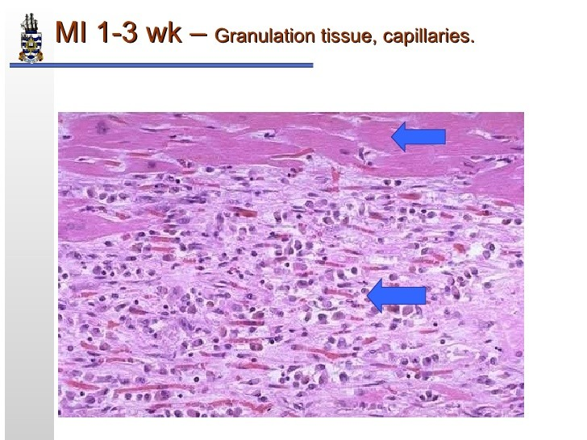

Slide 66
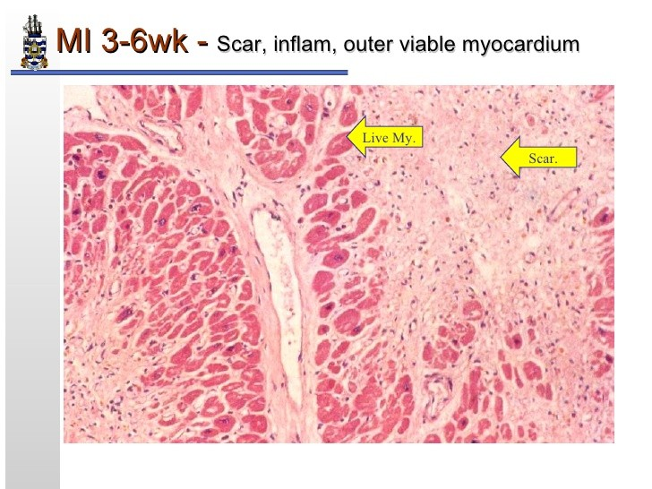

Slide 69
Conditions mimicking STEMI
PERICARDITIS
BER
VENTRICULAR ANEURYSM
BRUGADA SYNDROME
AORTIC DISSECTION
PULMONARY EMBOLISM
Neth Heart j.2008 oc

Slide 70
Continues--
LBBB
LVH
PRINZMETALS ANGINA
HYPOTHERMIA
HYPERKALEMIA

Slide 71
Pericarditis

Slide 74
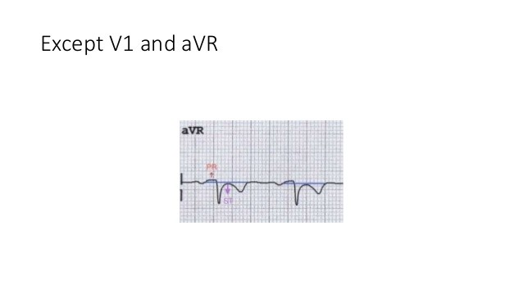

Slide 79
Persistent ST elevation in LV aneurysm

Slide 80
Brugada syndrome
Sodium channelopathy
> 60 mutations
50% Spontaneous mutation
Familial
Brugada sign------ECG

Slide 82
ECG abnormality must be associated with one of the following
Polymorphic VT/VF
Family H/O sudden cardiac death
Inducibility of VT with programmed electrical stimulation
Syncope
Nocturnal agonal respiration

Slide 83
LVH

Slide 84
Prinzmetals angina

Slide 85
Hypothermia---Osborn wave

Slide 86
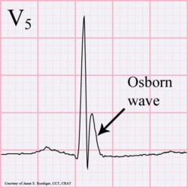

Slide 88
Question
1.Match the time after onset of MI with the histological features/clinical event
1.coagulation necrosis, wavy fibers,infiltration of interstitium by polymorphonuclear infiltrates
2.scar with dense collagen fibers
3. thrombotic coronary artery with no histopathological changes.
4.Rupture of ventricular wall
(A)2hr ( B)12 hr (C) 4-7 days (D) 6 weeks

Slide 89
Questions 2
a 16 year old boy presented with DOE and palpitation for the past 1 month. He had no other respiratory symptoms or fever. He was a non smoker , non hypertensive and non diabetic.His younger brother died suddenly a year earlier

Slide 90
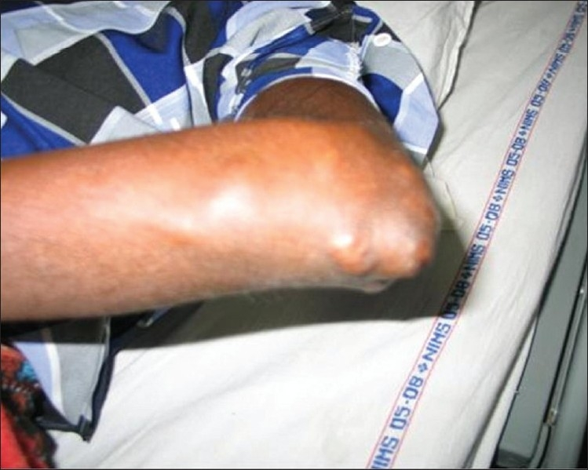

Slide 91
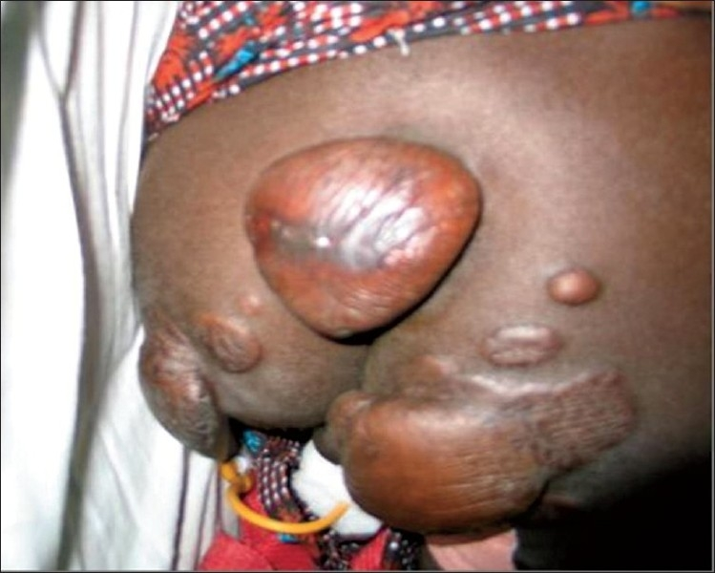

Slide 92
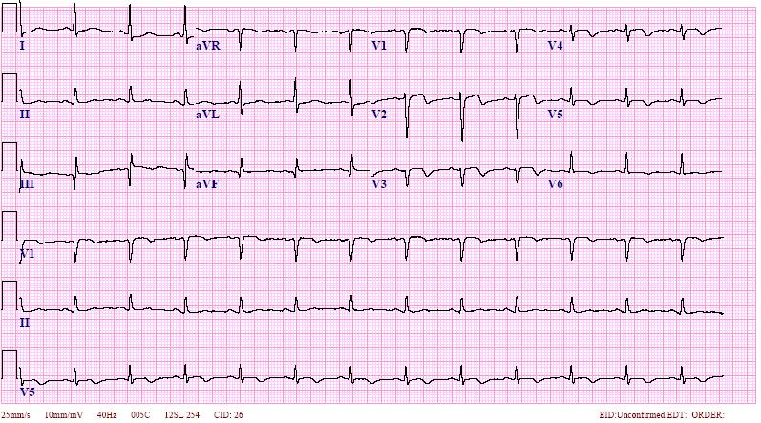

Slide 93
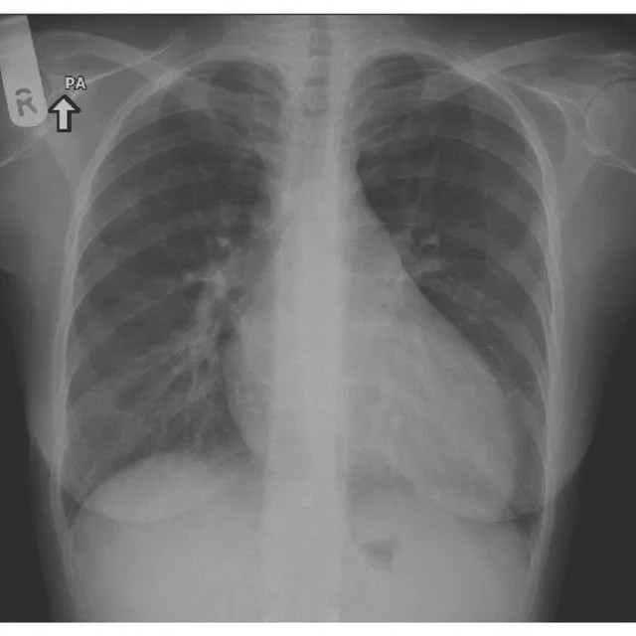

Slide 94
2D Echo/CAG
2D Echocardiogram
dilated LV with severe LV systolic dysfunction and akinetic interventricular septum, moderate MR .
CAG----- 90% discrete, ostialstenosis of the left main coronary artery and severe proximal LAD disease.

Slide 95
???????????????????

Slide 96
Answer
child had FAMILIAL HYPERCHOLESTROLEMIA
Clinically suspected because of tendinous and tuberous xanthomas with strong family history
Total cholestrol---440 mg/dl
LDL -------------398 mg/dl
HDL ----------------30 mg/dl
TG ----------------60 mg/dl

Slide 97
QUESTION 3
A 69 yr old male with h/o HTN and t2DM presented with sudden onset of substernal chest pain and SOB.patient was anxious and diaphoretic in the emergency.vital signs showed a BP reading of 130/90 mmHg and HR of 68bpm.
Physical examination was otherwise unremarkable.

Slide 99
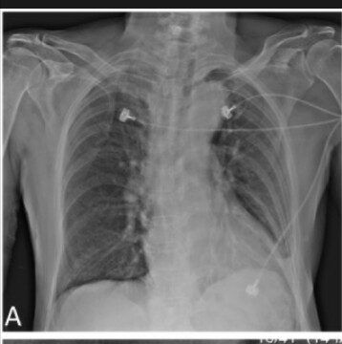

Slide 100
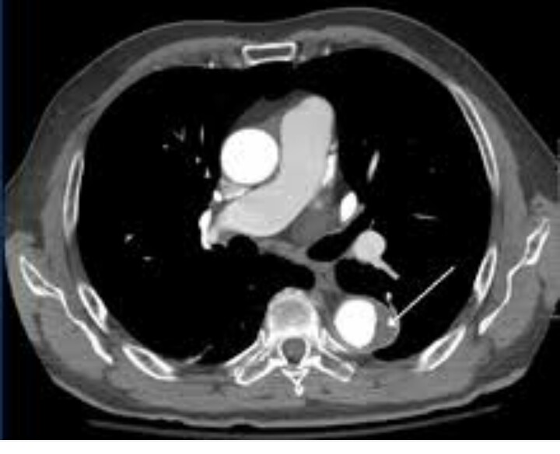

Slide 101
ANSWER
Aortic Dissection

Slide 102
QUESTION 4
A63 yr old man was brought to emergency dept in cardiac arrest.he had a h/o HTN , DLP, CAD.pt c/o dizziness and dyspnoea prior to his syncope.his initial BP was 70/40mmHg , HR 68bpm , SPO2 82% in RA.

Slide 103
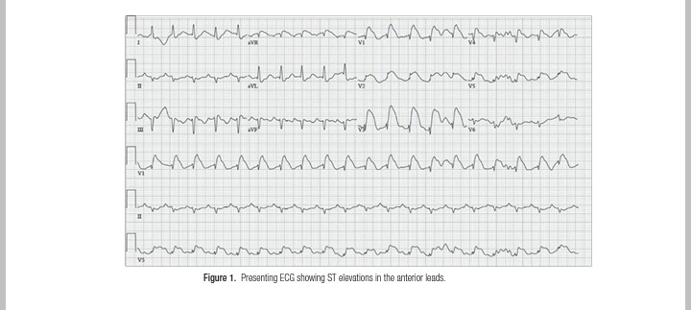

Slide 104
-------
CAG
Non obstructive epicardial coronary arteries and patent LAD
2D ECHO
Dilated Rt ventricle
Rt sided heart catheterisation revealed RV pressure of 80/30mmHg

Slide 105
-----------------
??????????????????????????

Slide 106
Pulmonary angiogram disclosed filling defect s/o B/L pulmonary embolism

